Slide 1
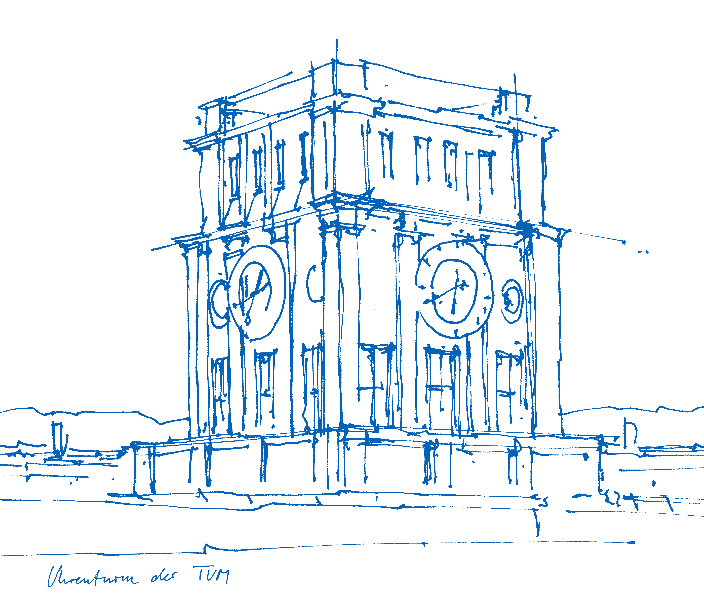
Viewccelera - Manual
Bernhard Gleich
Technical University of Munich Munich Institute of Biomedical Engineering

Slide 2
Features
Viewer for data files from Accelera Software
Open *.csv and *.time file from Accelera (corresponding *.csv and *.time file must be in the same directory)
Plots an overview plot (absolute value of acceleration) and plots single event data
User can select start and stop points in the event data plot for automatic data analysis for eacht single event
Export of plots as *.png files
Export of data as *.csv files

Slide 3
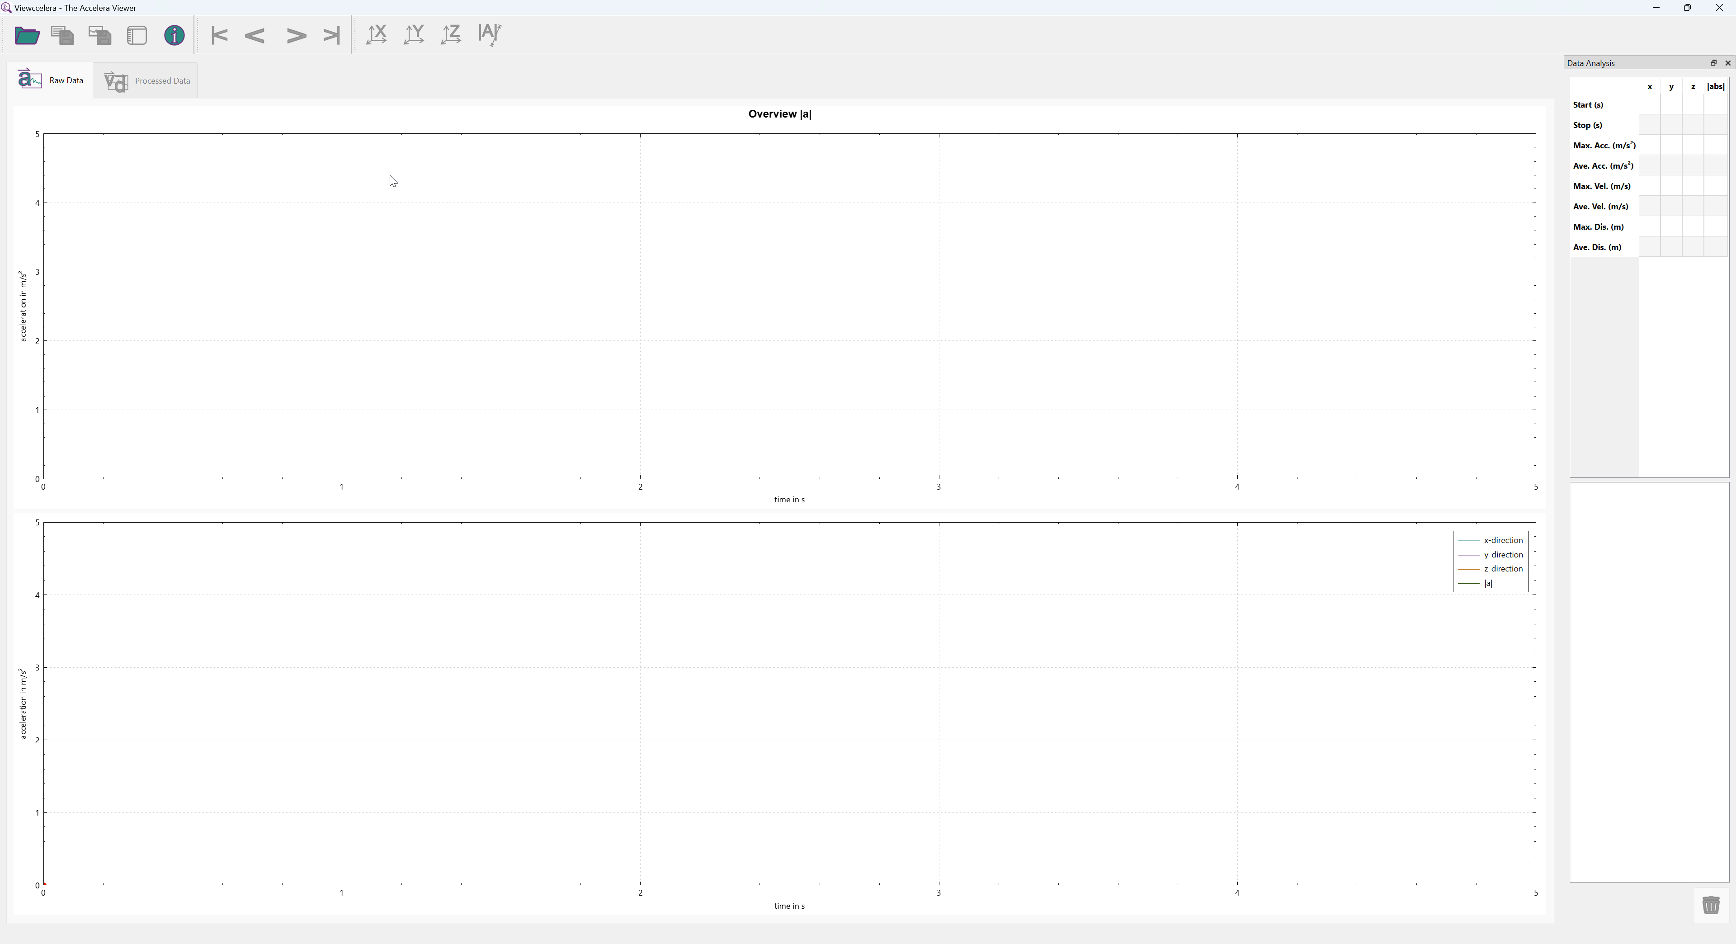
Start up
Open a data file
Show first event, previous event, next event or last event in the bottom plot
Dockable Widget which shows analysis results of the current event
Export as CSV or PNG file
t-|a| plot of the whole dataset
Select which direction (x, y, z or ||) should be shown in the bottom plot
Tabs to switch between the raw data plots and the processed data plots
plot of the current event only
List of all analyzed event
Delete analysis of selected event

